Slide 1
Machine Learning Take 1
Joseph Lanser

Slide 2



z
Step 1: Further clean code to include only the variables I want to use for ML
Step 2: Code monthly case start dummies
Step 3: Decide what I want to segment, or leave continuous
FICO, TSR, CDSS left continuous for now
Also included Credit Segments, Charge/Lend Dummies, Cust/SmBus Dummies, Total balance due, Balance Due as % of Exposure, Multiple products Dummy, and Tenure

Slide 3

What the Random Forest code does:
Builds the feature set X = all variables except the target (past_60_bi)
Starts/attaches to H2O
Trains a Random Forest with:
ntrees(500), maxdepth(8), predsampvalue(3) (mtry=3), samprate(.632) (bootstrap), h2orseed(42).
Gets training predictions
Computes training accuracy at 0.50 and at a grid-searched best threshold (0→1 by .01).
Creates a 67/33 train/test split inside H2O, retrains on train, predicts on test.
Evaluates test accuracy at 0.50 and at the training-chosen threshold.
z

Slide 4

z
Results:
Class discrimination (TRAIN):
AUC ≈ 0.72 → moderate separation power (better than chance, not perfect).
Generalization (TEST, 33% holdout):
Accuracy @ 0.50: ~0.809
Accuracy @ train-chosen 0.38: ~0.794
Since 0.50 slightly beats the train-tuned 0.38 on the test set, I should choose thresholds using a separate validation split (not training) for reliable operating points.

Slide 6

What the Gradient Boosting code does:
Builds the feature set X = all variables except the target (past_60_bi).
Starts / connects to an active H2O cluster.
Trains a Gradient Boosting Machine (GBM) with:
ntrees(500), maxdepth(5), h2orseed(42)
H2O’s default learning rate (≈ 0.1) and sampling rates (≈ 1).
Gets training predictions and computes:
Accuracy at 0.50 threshold
Accuracy at best threshold (grid-searched from 0 → 1 by .01).
Creates a 67/33 train/test split within H2O, retrains on the train split, and predicts on the test split.
Evaluates test-set accuracy at 0.50 and at the best training threshold.
Computes AUC (ROC) for both training and holdout sets.
z

Slide 7
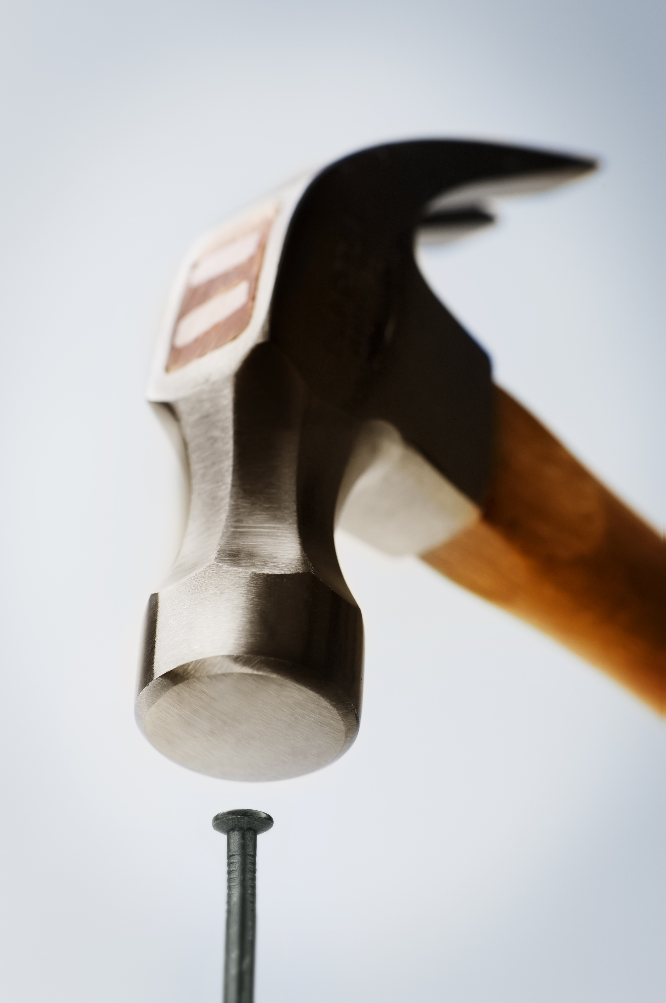
Results:
Class discrimination (TRAIN):
AUC ≈ 0.949 → very strong separation power on the training data.
Accuracy @ 0.50: 0.891
Accuracy @ best threshold (≈ 0.37): 0.910
Indicates the model fits training data well and finds an effective probability cutoff.
Generalization (TEST, 33% holdout):
AUC ≈ 0.686 → only mild discrimination on unseen data.
Accuracy @ 0.50: 0.787
Accuracy @ train-chosen 0.37: 0.761
z

Slide 9
Comparison of results:
Metric | Random Forest | Gradient Boosting (GBM)
Train AUC | 0.72 | 0.949
Train Acc @ 0.50 | .806 | 0.891
Train Acc @ best thr | .824 (best thr ≈ .39) | 0.910 (best thr ≈ 0.37)
Test AUC (33% holdout) | 0.81* | 0.686
Test Acc @ 0.50 | 0.809 | 0.787
Test Acc @ train-chosen thr | .794 (thr ≈ 0.39) | 0.761 (thr ≈ 0.37)

Slide 10

Headline takeaways:
RF generalizes better on the 33% holdout (higher test AUC/accuracy).
GB is much stronger in training (very high AUC) but drops on test → clear overfitting with current settings.
I think GB is going to be a better choice than RF for this circumstance, we just need to dial in the variables and methodology to not overfit in training.
z

